Slide 1
Results Antonym generation

Slide 2
Generate Antonyms from scratch
Approach:
User selects a category (e.g. Countries)
Search Wikipedia for entries from this category (e.g. Germany)
Retrieve Wikipedia articles
Look up antonyms for each word used in the article
Add word- antonym pair to set of pairs
Select Top n (e.g. 300) pairs with “Orthogonality maximization” (from POLAR)
Transfer model into Polar space (from POLAR)

Slide 3
Example Countries
Used Wikipedia pages of Countries with biggest GDP
United States, China, Japan, Germany, United Kingdom, France, India, Italy, Canada, Russia
Generated Antonym pairs: 1677 (adding more countries didn’t increase this Number too much)
Applied Polar with 300 Dimensions
First observation: Most generated antonyms are very general and non-expressive for the category, e.g.
('known', 'unknown'), ('equal', 'differ'), ('central', 'peripheral'),('major', 'minor'), ('square', 'round'), ('straight', 'crooked'), ('most', 'fewest'), ('most', 'least'), ('uppercase', 'lowercase'), ('new', 'old'), ('new', 'worn'), ('least', 'most’) ('notice', 'ignore'), ('marked', 'unmarked'), ('worsen', 'better'), ('refuse', 'accept'),
However, some interesting ones:
('north', 'south’), ('urban', 'rural'), ('military', 'civilian'), ('nuclear', 'conventional'), ('civil', 'uncivil'), ('war', 'peace'), ('export', 'import')

Slide 4
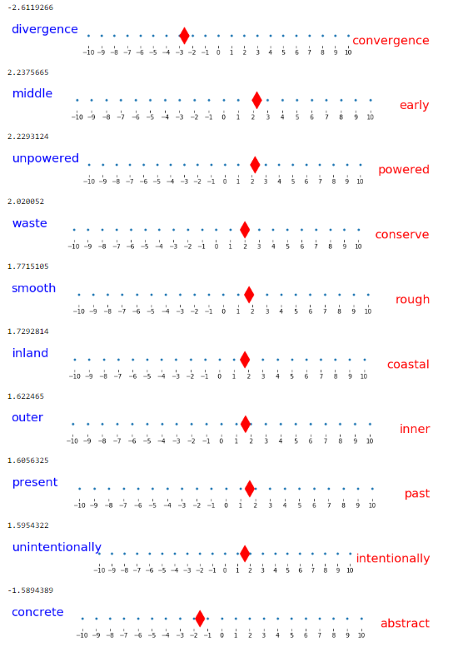
USA

Slide 5
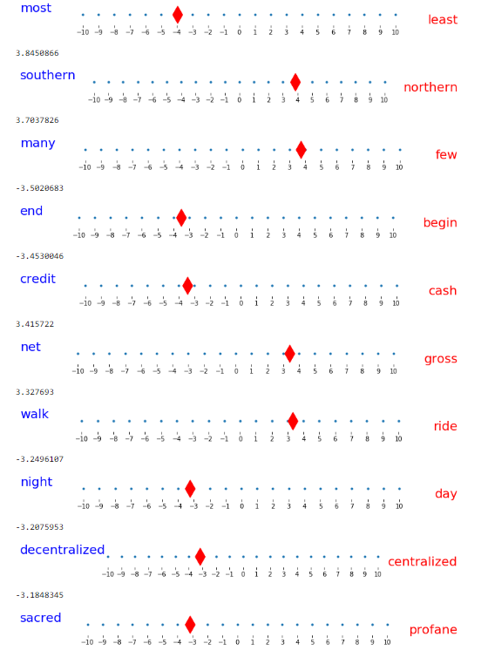
China

Slide 6
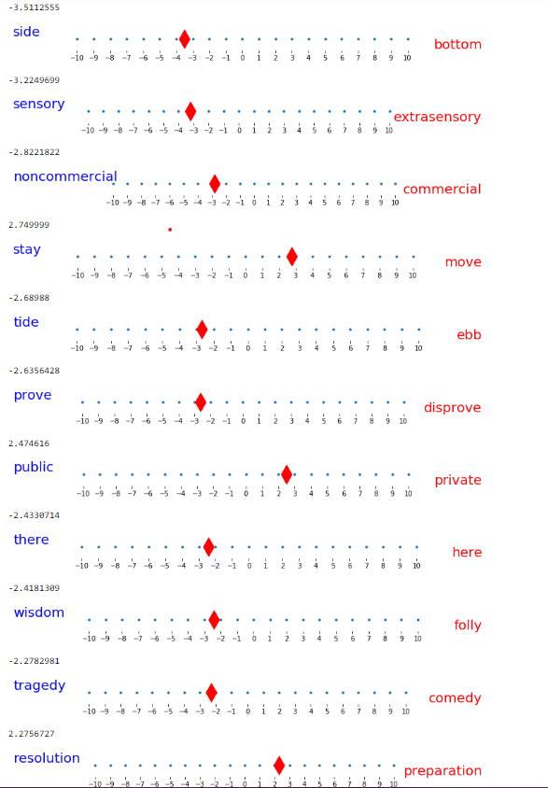
Can you guess the country? Probably not

Slide 7
Same for music genres
We marked in red the pairs we think are interesting:
('popular', 'unpopular'), ('like', 'dislike'), ('like', 'unlike'), ('traditional', 'nontraditional'), ('equal', 'differ'), ('most', 'fewest'), ('most', 'least'), ('on', 'off’), ('western', 'eastern'), ('many', 'few'), ('deviate', 'conform'), ('take', 'give'), ('accept', 'refuse'), ('necessitate', 'obviate'), ('consume', 'abstain'), ('claim', 'disclaim’), ('sound', 'silence'), ('have', 'lack'), ('new', 'old'), ('new', 'worn'), ('adopted', 'native'), ('record', 'erase'), ('studio', 'location'), ('particular', 'general'), ('specific', 'general’), ('specific', 'nonspecific'), ('used', 'misused'), ('general', 'particular'), ('general', 'specific'), ('general', 'local'), ('more', 'less'), ('more', 'fewer'), ('familiar', 'unfamiliar'), ('familiar', 'strange’), ('win', 'lose'), ('gain', 'reduce'), ('popularity', 'unpopularity'), ('powerful', 'powerless'), ('appearance', 'disappearance'), ('late', 'early'), ('begin', 'end'), ('start', 'stop'), ('cover', 'uncover’)

Slide 8
First Conclusion: We need some “Guidance”
“Hard code“ 50 specialized pairs for each category
Example Country: Observation: Many don’t have “real” antonyms
Geographic
east west
north south
europa asia
america eurasien
africa australia
scandinavian baltic
america russia
america china
russia china
atlantic pacific
Language:
latino hispanic
english russian
english chinese
english spanish
spanish portuguese
Landscape:
ocean land
large small
arctic southern
island neighbor
flat mountain
coast border
metropolitan rural
cityside countryside
big tiny
long wide
Colors:
black white
brown yellow
grey green
grey blue
Politics& People:
civilized uncivilized
modern traditional
catholic muslim
catholic buddhism
hindi muslim
democratic monarchic
potato rice
calm busy
cosmopolitan provincial
touristy limited
Weather:
dry humid
hot cold
tropical mediterranean
desert vegetation
Money making:
export import
banking agriculture
port airport
developed undeveloped
first third
poor rich
farming development

Slide 9
Generate Antonyms (Three different approaches)
First Approach:
1. Create root antonyms for selected category (e.g. Countries)
a. create 50 different antonym pairs by hand
b. select 50 antonym pairs from original antonyms which are most similar topic (country)
2. Generate new antonym pairs from root antonym
a. for every word in root antonyms find its synonym, hyponym set , then find antonyms for all these words using wordnet. (observation: wordnet can only produce few antonym pairs)
b. for every word in root antonyms find its synonym and antonym from API: http://www.thesaurus.com using Web Crawler. (observation: this method produce plenty of antonym pairs)
3. Combine all generated antonym pairs
a. do some processing to root antonym pairs, antonym pairs from wordnet, antonym pairs from API
b. collect all three antonym pairs set to generate final antonym pairs

Slide 10
Apply Polar Framework
Select Top n subset of Antonym pairs (e.g. 300 dimension)
a. select first antonym vector with maximal variance
b. select other antonym vector with “Orthogonality maximization” (from POLAR)
Transfer word vector into Polar space (from POLAR)
Word vector std normalization

Slide 11
Results Visualization and Evaluation

Slide 12
Root antonyms(e.g. country)
[('country', 'metropolitan'), ('continent', 'sea'), ('export', 'import'), ('cooperation', 'rivalry'), ('industry', 'nature'), ('party', 'work'), ('defund', 'promotional'), ('business', 'recreation'), ('citizen', 'emperor'), ('decentralize', 'streamline'), ('hot', 'cold'), ('city', 'nature'), ('mountainous', 'oceanic'), ('disadvantageous', 'good'), ('peaceful', 'sandstorm'), ('north', 'west'), ('kind', 'nasty'), ('even', 'uneven'), ('rock', 'wood'), ('east', 'west'), ('aridity', 'saturation'), ('customer', 'worker'), ('conflict', 'peace'), ('nationality', 'solitude'), ('funded', 'impoverished'), ('committee', 'individual'), ('openness', 'stockade'), ('history', 'news'), ('expand', 'reduce'), ('common', 'royal'), ('modern', 'past'), ('communism', 'freedom'), ('deconstruct', 'structure'), ('freedom', 'stockade'), ('power', 'weak'), ('endemic', 'foreign'), ('downfall', 'prime'), ('accountable', 'despotic'), ('fortune', 'trouble'), ('love', 'war'), ('friendly', 'mean'), ('expensive', 'thrifty'), ('growth', 'reduce'), ('fear', 'safe'), ('river', 'sea'), ('friendship', 'rivalry'), ('peace', 'violent'), ('structured', 'unstructured'), ('cheap', 'value'), ('invade', 'placate'), ('provident', 'wasteful'), ('lavish', 'thrifty'), ('benefit', 'injure'), ('army', 'marine'), ('democratic', 'despotic'), ('unemployment', 'workforce'), ('religion', 'science'), ('cleanse', 'corrupt'), ('low', 'top'), ('home', 'work')]

Slide 13
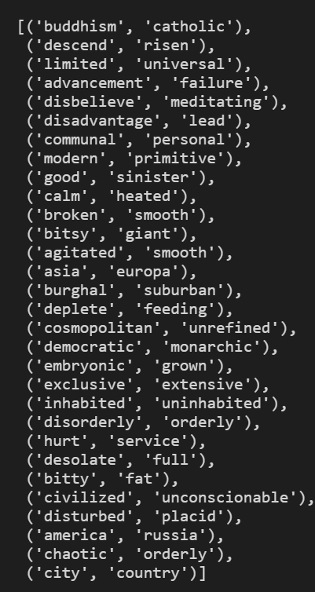
Overview of generated antonym pairs
Randomly select 30 antonym pairs from final antonym pairs

Slide 14
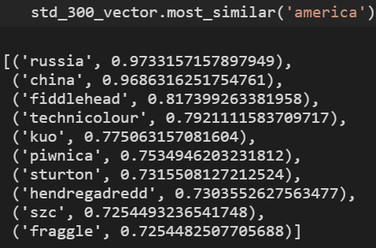
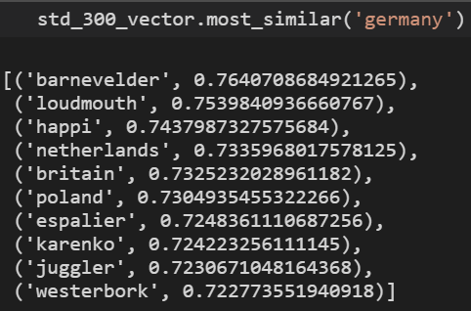
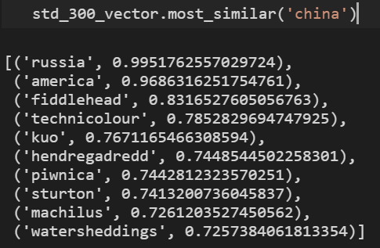
Result of most similar words

Slide 15
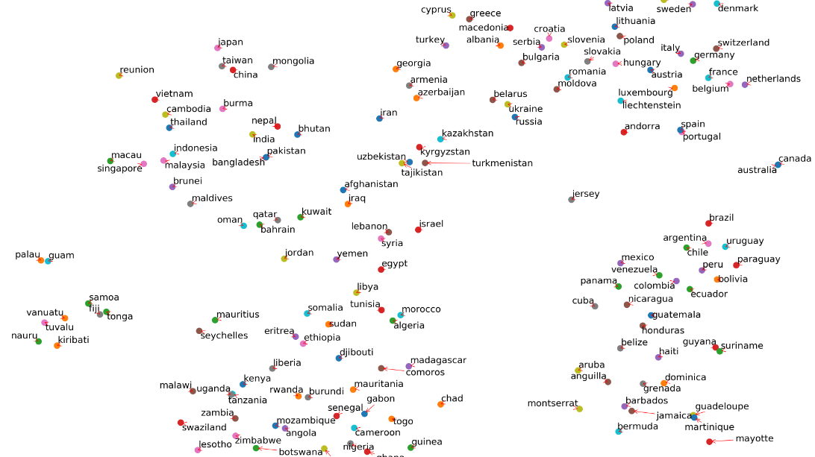
All country visualization
Before polar transformation

Slide 16
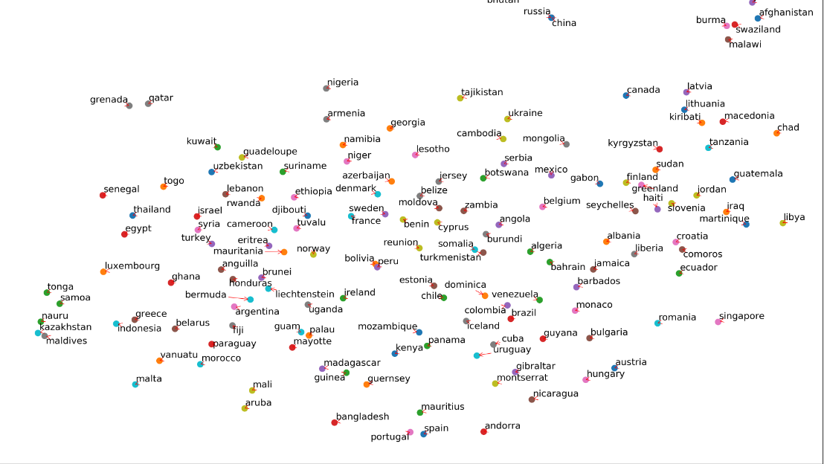
All country visualization
After polar transformation

Slide 17
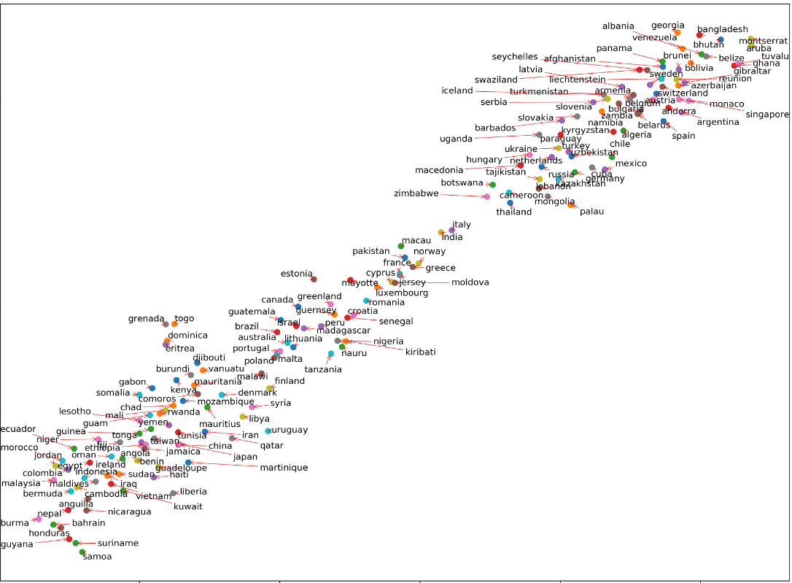
Country visualization after polar (using original antonyms)

Slide 18
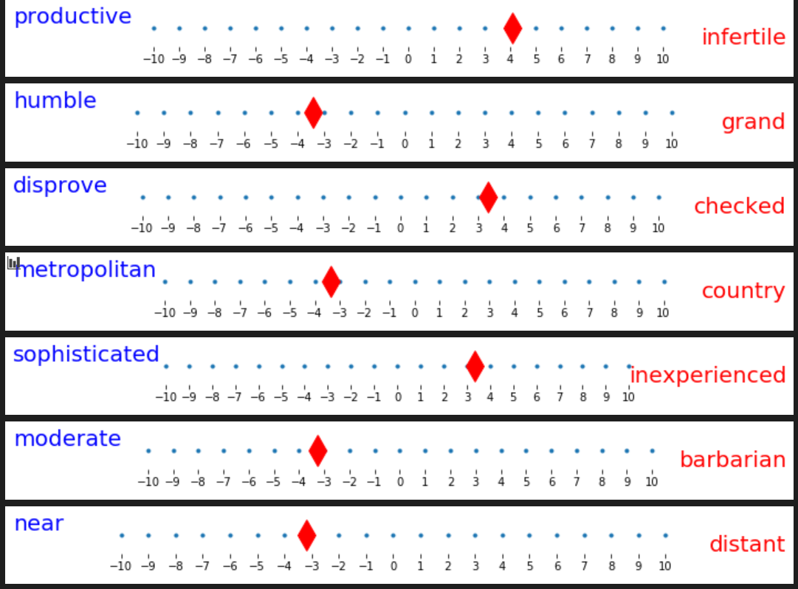
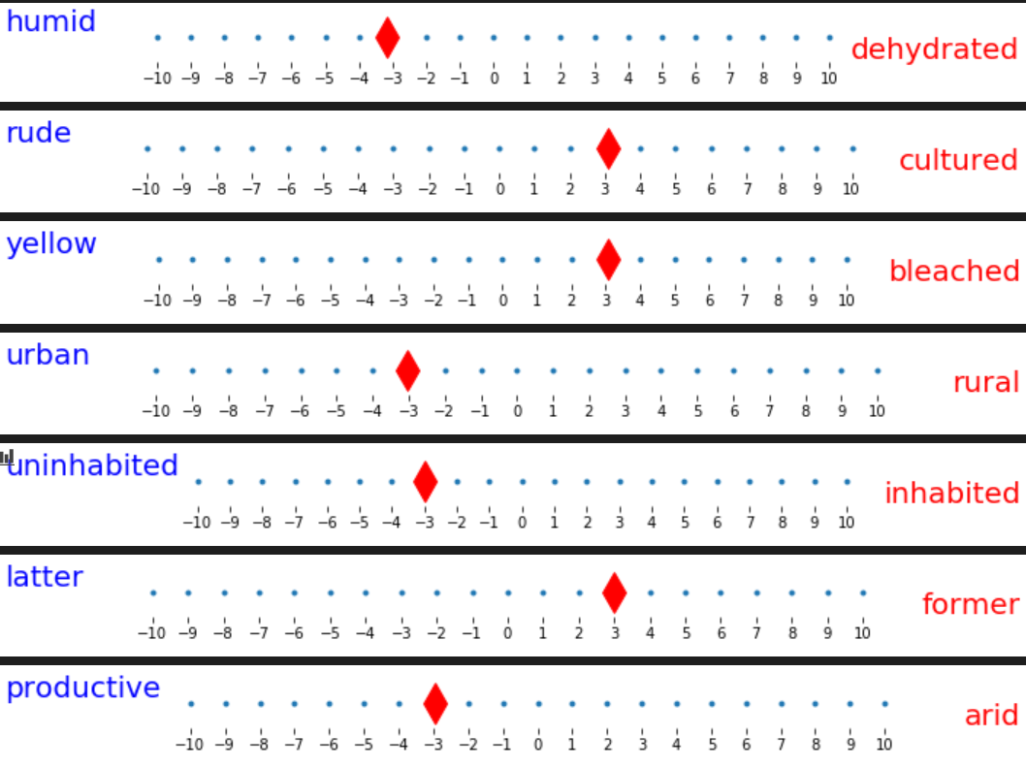
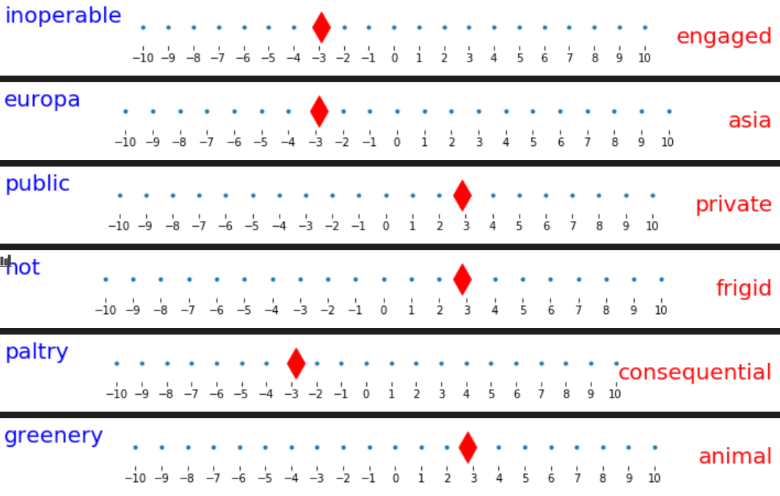
England

Slide 19
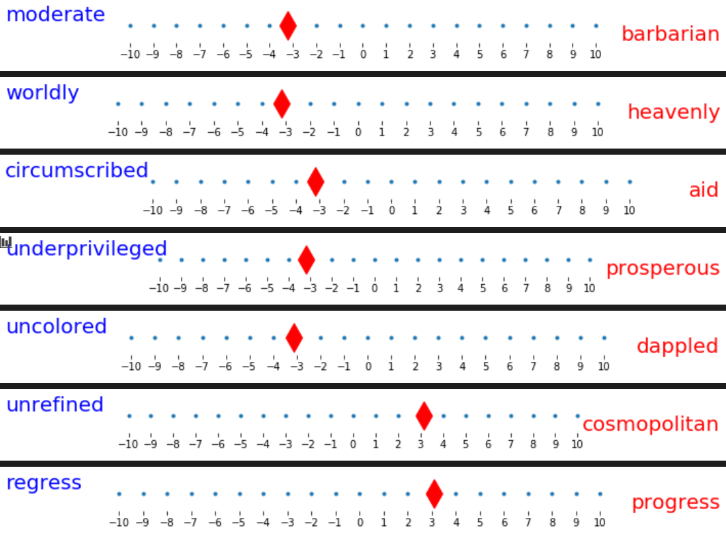
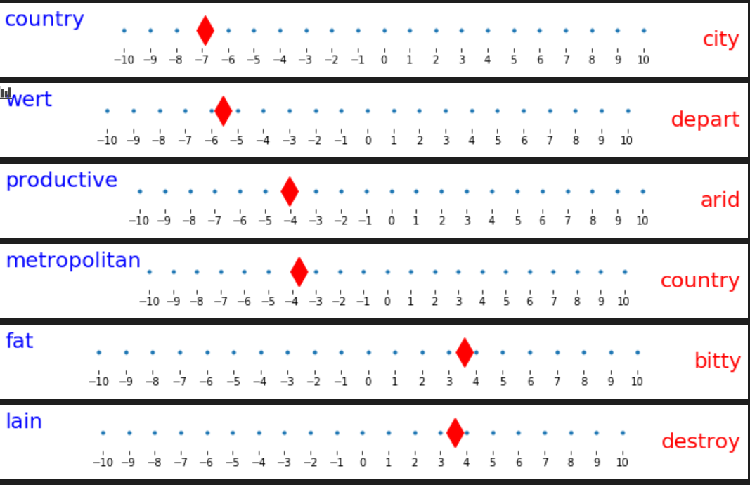
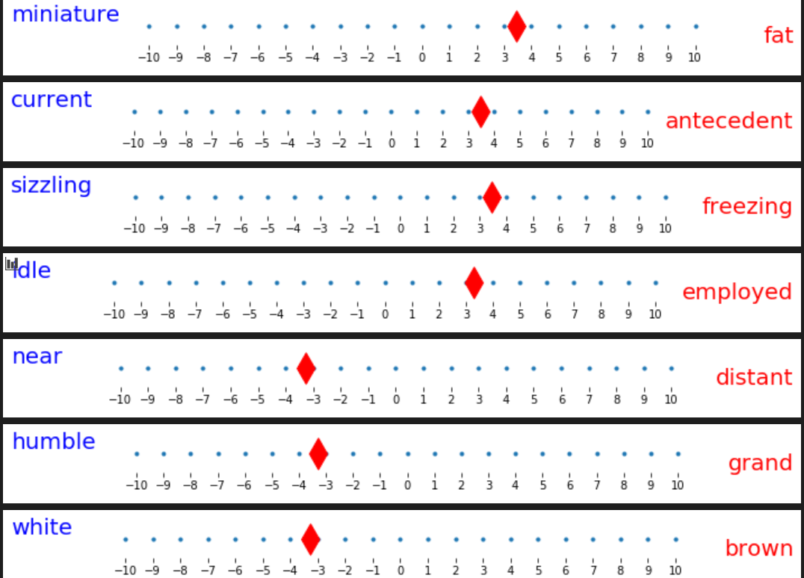
Germany

Slide 20
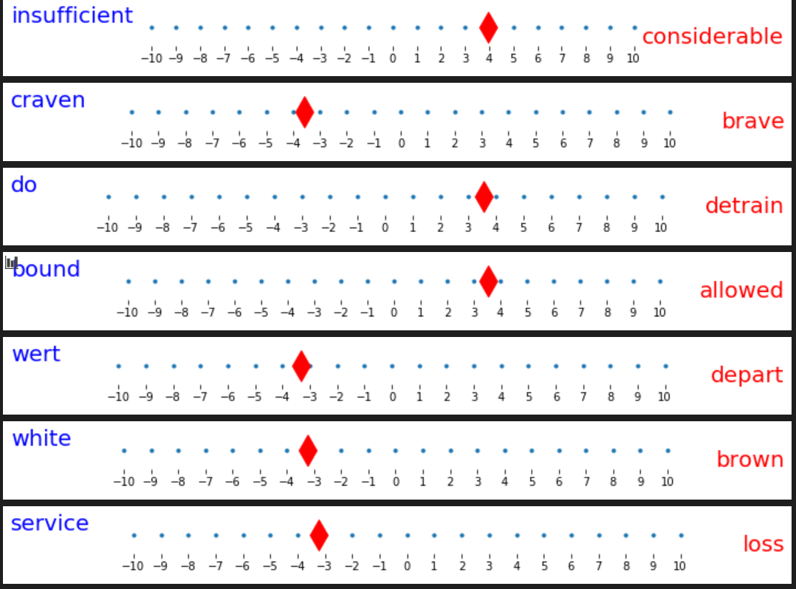
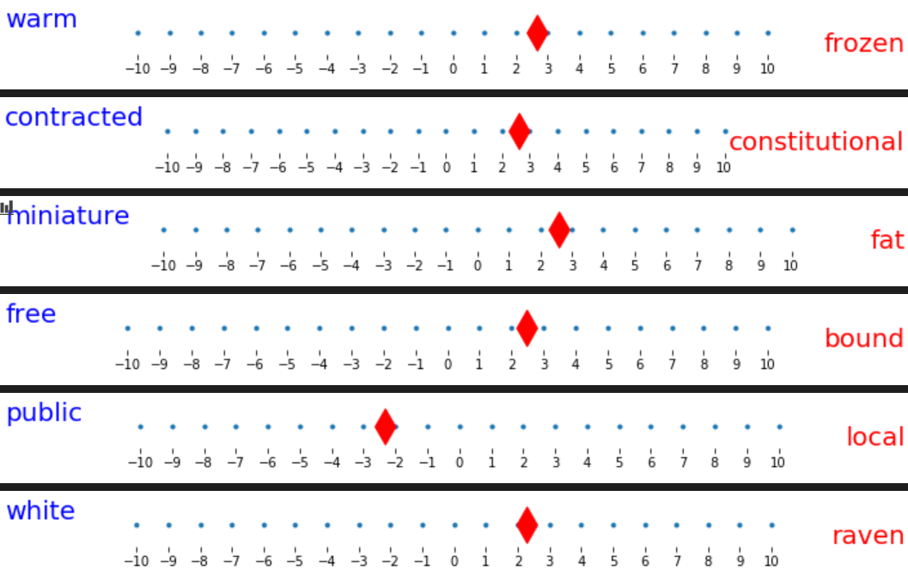
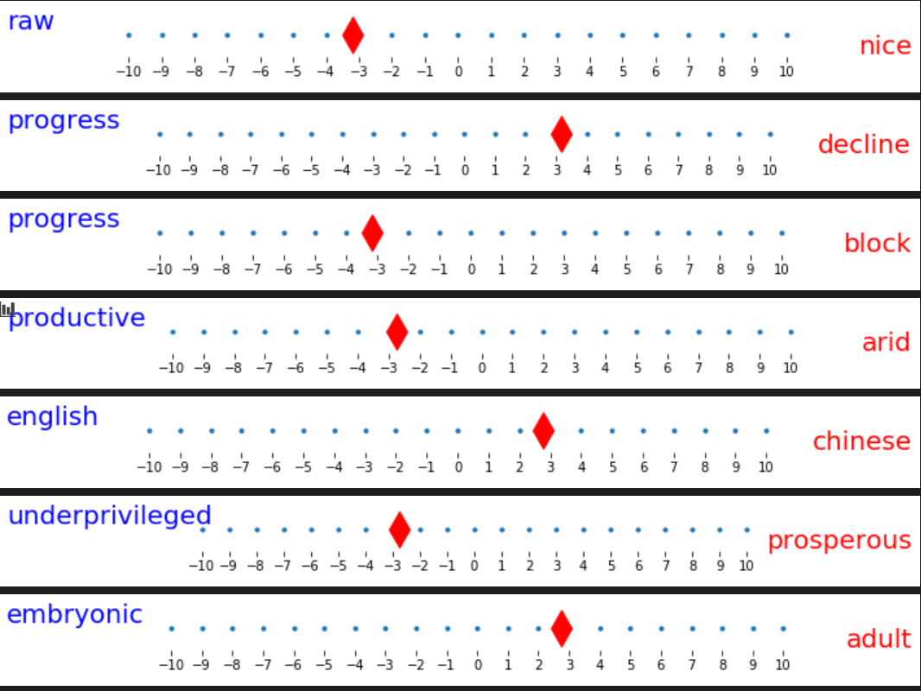
China

Slide 21
I have also done some experiment for topic “food” and “music”.
And I compared the results between using generated antonyms and using original antonyms.
I also compared the result before polar transformation and after polar transformation.

Slide 22
Some conclusions
1. The quality of results is depending on the quality of antonym pairs
2. The more different aspects antonym pairs contain, the better result it has (e.g. original antonyms works better than generated antonyms)
3. The root antonym is very important, it limited the final generated antonyms and influenced the final results
4. Sometimes the generated antonyms is “bad”, it contains some general antonym pairs like (big, small) (bad, good)…
5. Sometimes the polar transformation works bad. (e.g. when search most similar words in trained model)

Slide 23
4. Approach
Start with hardcoded 50 antonyms
Instead of using synonyms, use similar words and look up their antonyms from www.synonyms.com
word2vec.wv.most_similar('america')
Example: ("salty", "sweet")
Using word2vec.wv.most_similar()
[('salty', 'sweet'), ('tangy', 'sweet'), ('savoury', 'tasteless'), ('pungent', 'tasteless’) ('fruity', 'sane'), ('fruity', 'tasteless'), ('sour', 'tasteless'), ('sour', 'fragrant'), ('sour', 'sweet'), ('sour', 'cloying'), ('sour', 'harmonious'), ('sour', 'syrupy'), ('sour', 'sweeten'), ('sour', 'honeyed'), ('sour', 'luscious'), ('sour', 'wholesome'), ('sour', 'untainted'), ('spicy', 'tasteless'), ('spicy', 'cold'), ('spicy', 'dull’)]
Pungent: having a sharply strong taste or smell.
tangy flavor: or smell is one that is sharp, especially a flavor like that of lemon juice
Using synonyms:
[('sweetness', 'unpleasantness')]

Slide 24
Still, generated antonyms are too general
('boggy', 'dry') ('downy', 'hard') ('conciliatory', 'cutting') ('bounded', 'immeasurable') ('dim', 'white') ('evaporated', 'liquid') ('purple', 'yellow') ('unexploded', 'unloaded') ('pleasing', 'ugly') ('broken', 'entire') ('loaded', 'unloaded') ('company', 'loneliness') ('comfortable', 'warm') ('loathsome', 'wholesome') ('entirety', 'grain') ('green', 'red') ('shell', 'soft') ('finite', 'immeasurable') ('brief', 'immeasurable') ('dried', 'wet') ('excellent', 'inferior') ('dappled', 'plain') ('lovely', 'ugly') ('freezing', 'hot') ('neutral', 'pink') ('tall', 'thick') ('processed', 'unprocessed') ('empty', 'rich') ('aggregate', 'grain') ('coarse', 'delicious') ('preserved', 'unprocessed') ('insoluble', 'liquid') ('metal', 'nonmetal')

Slide 25
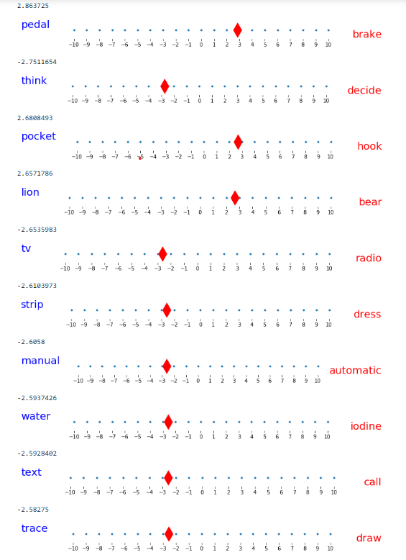
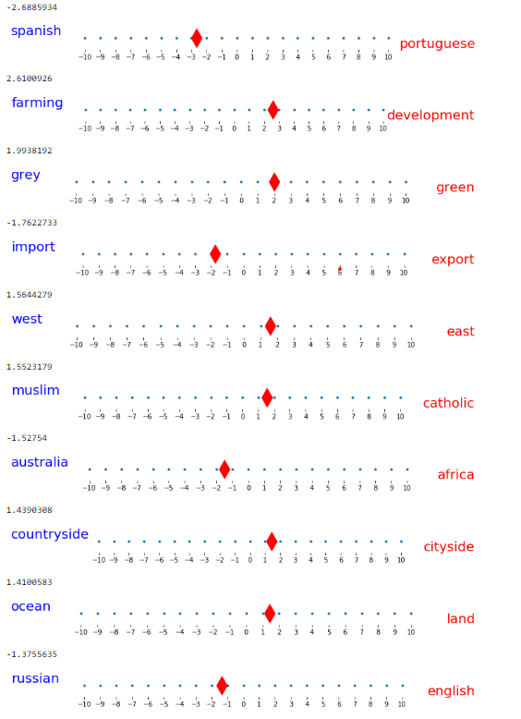
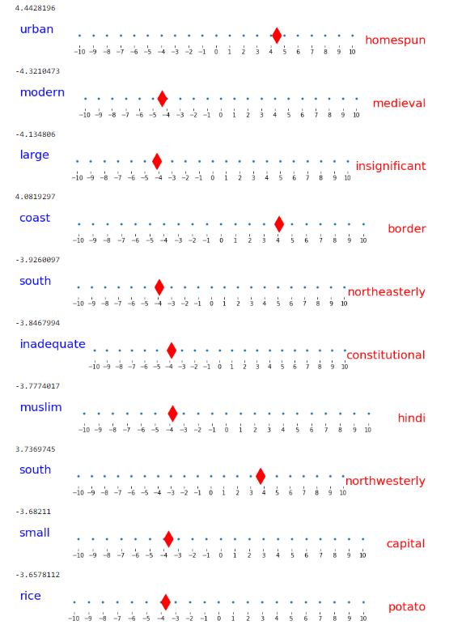
USA
Polar: 50 Hardcoded Extended

Slide 26
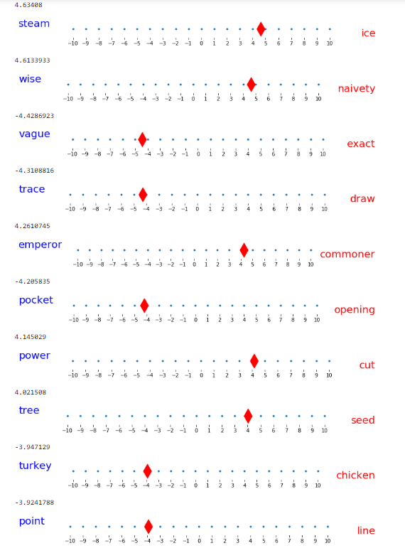
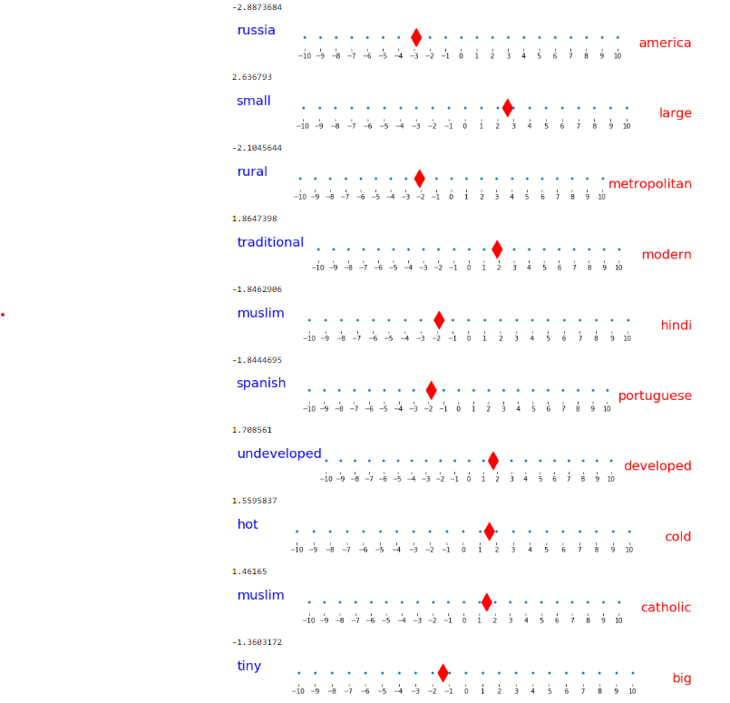
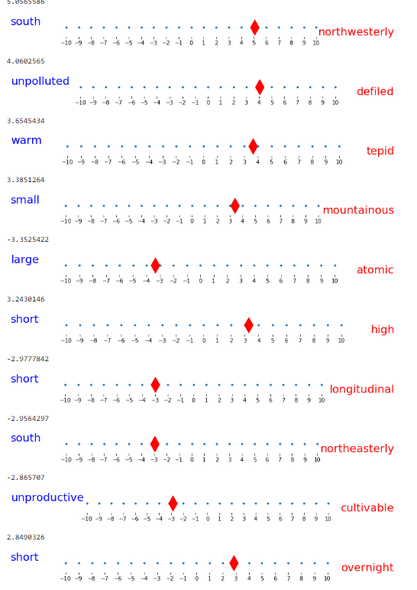
GERMANY
Polar: 50 Hardcoded Extended

Slide 27
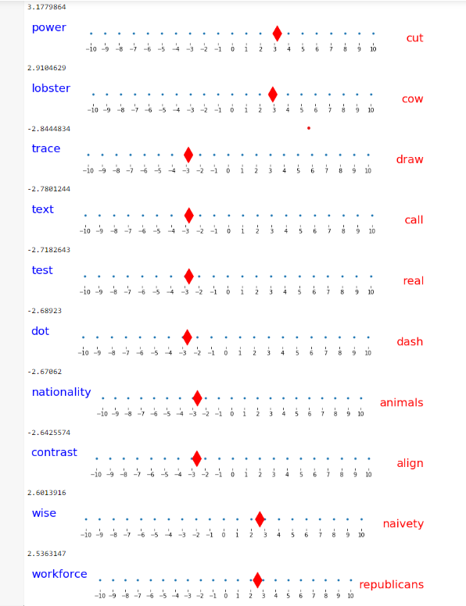
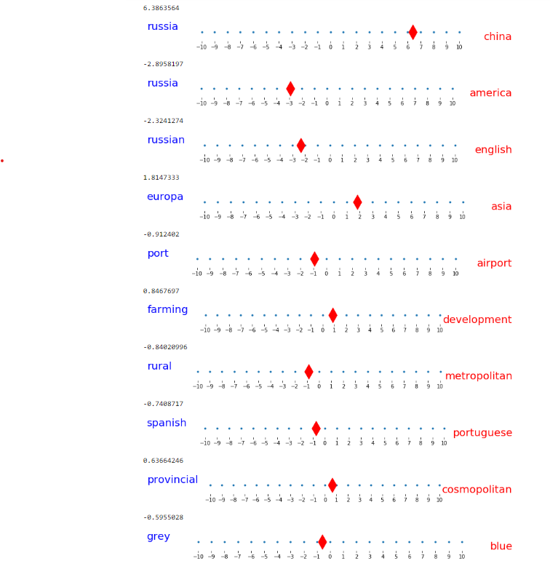
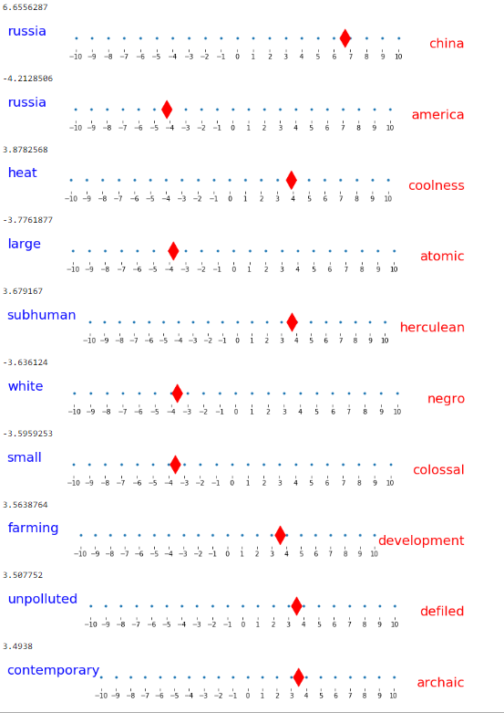
China
Polar: 50 Hardcoded Extended

Slide 28
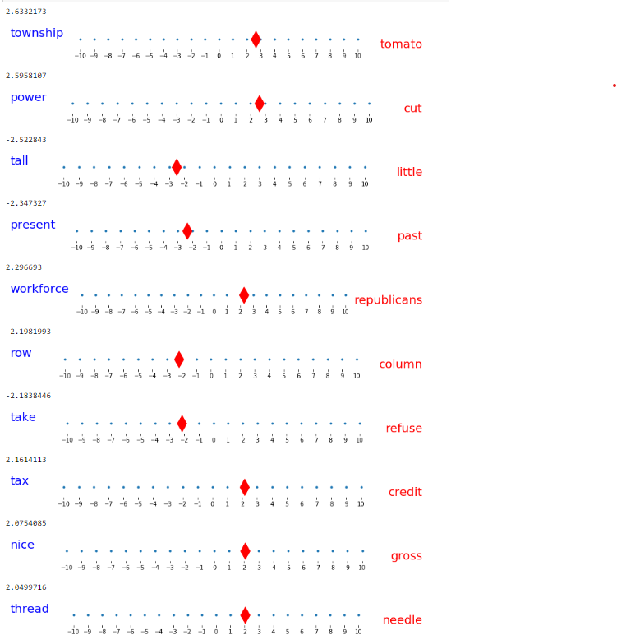
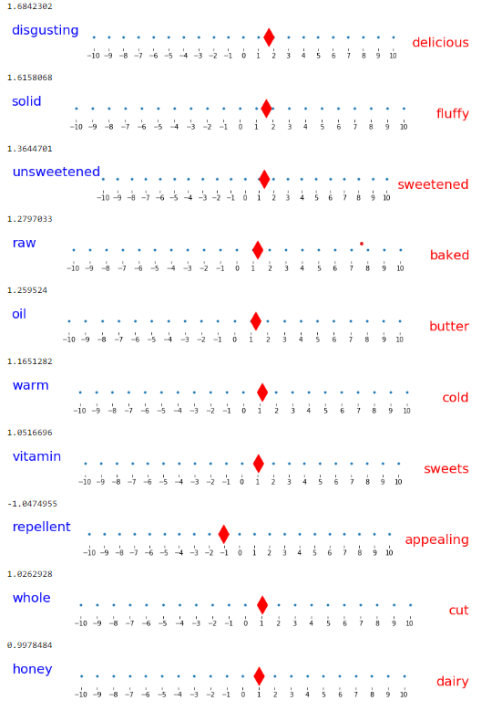
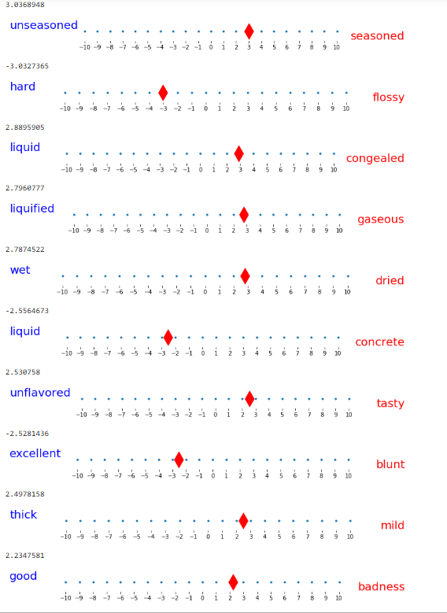
Steak
Polar: 50 Hardcoded Extended

Slide 29
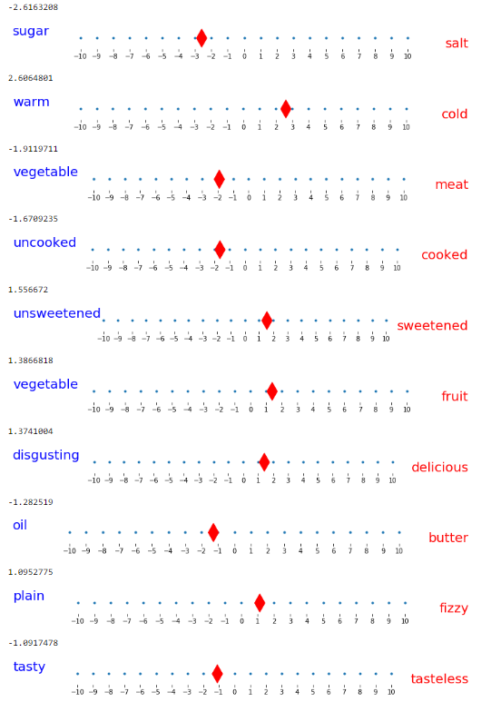
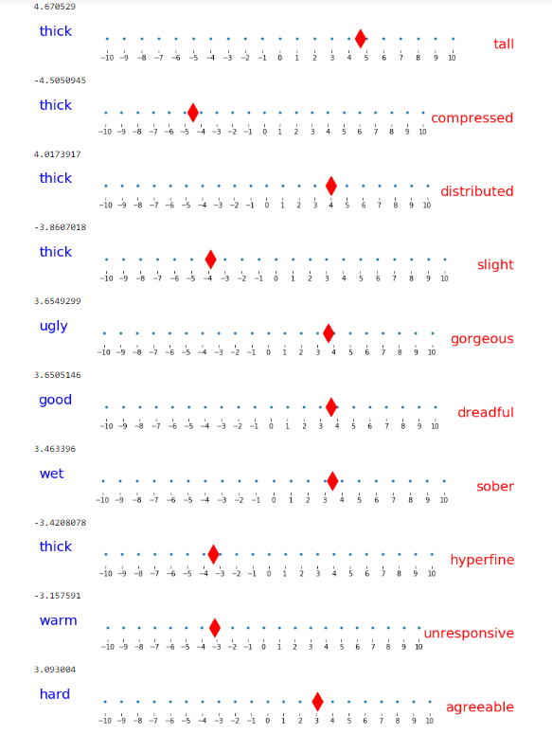
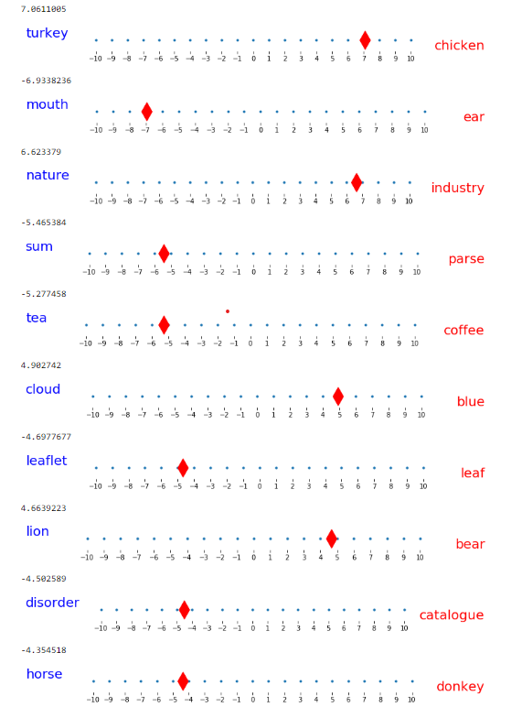
Banana
Polar: 50 Hardcoded Extended

Slide 30
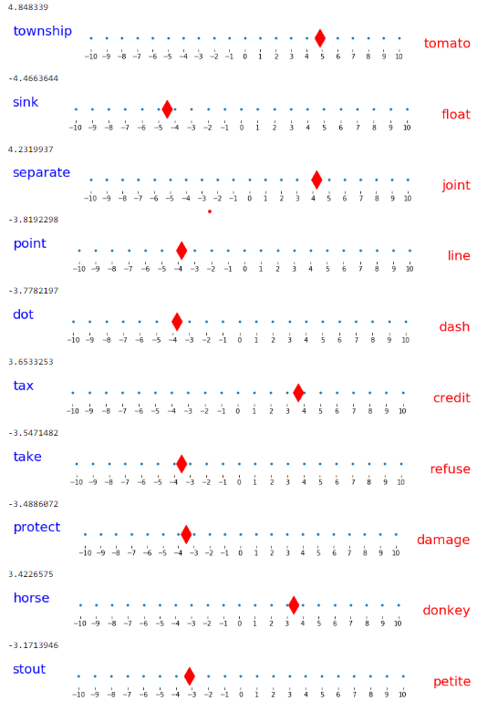
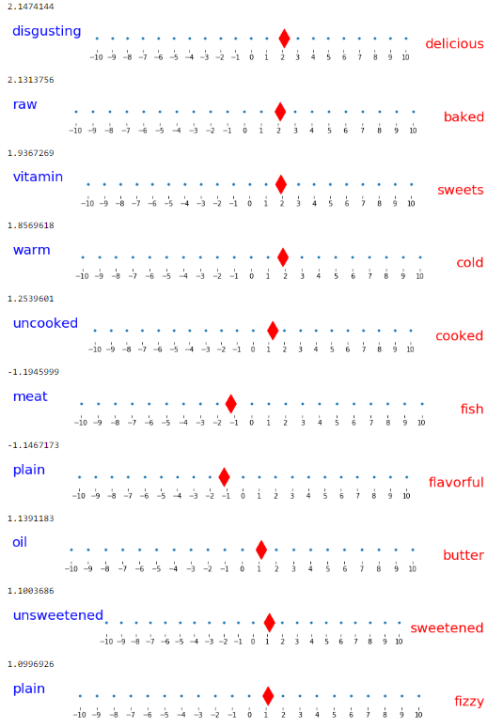
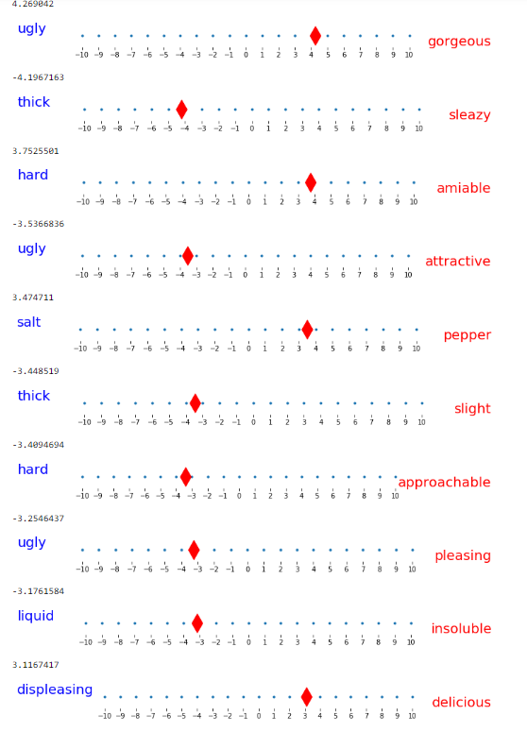
Cake
Polar: 50 Hardcoded Extended

